Slide 1
The pantomime game «a CROCODILE»
FOR 5 FORM
LET’S GO…………..

Slide 2
THE 1ST PART
Words for the first team
A pupil

Slide 3
Literature

Slide 4
Internet

Slide 5
Homework

Slide 6
Thank you

Slide 7
Time

Slide 8
A doctor

Slide 9
A letter

Slide 10
Words for the second team
A school

Slide 11
A computer

Slide 12
A stranger

Slide 13
A book

Slide 14
Children

Slide 15
An address

Slide 16
A teacher

Slide 17
Leaves

Slide 18
The 2nd part
The first team
Secondhand books

Slide 19
The second team
A lot of litter

Slide 20
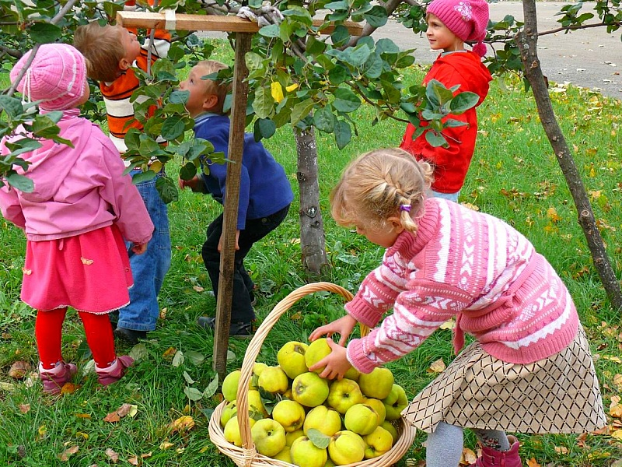
The 3rd part (final)
The first team
Explain the picture

Slide 21
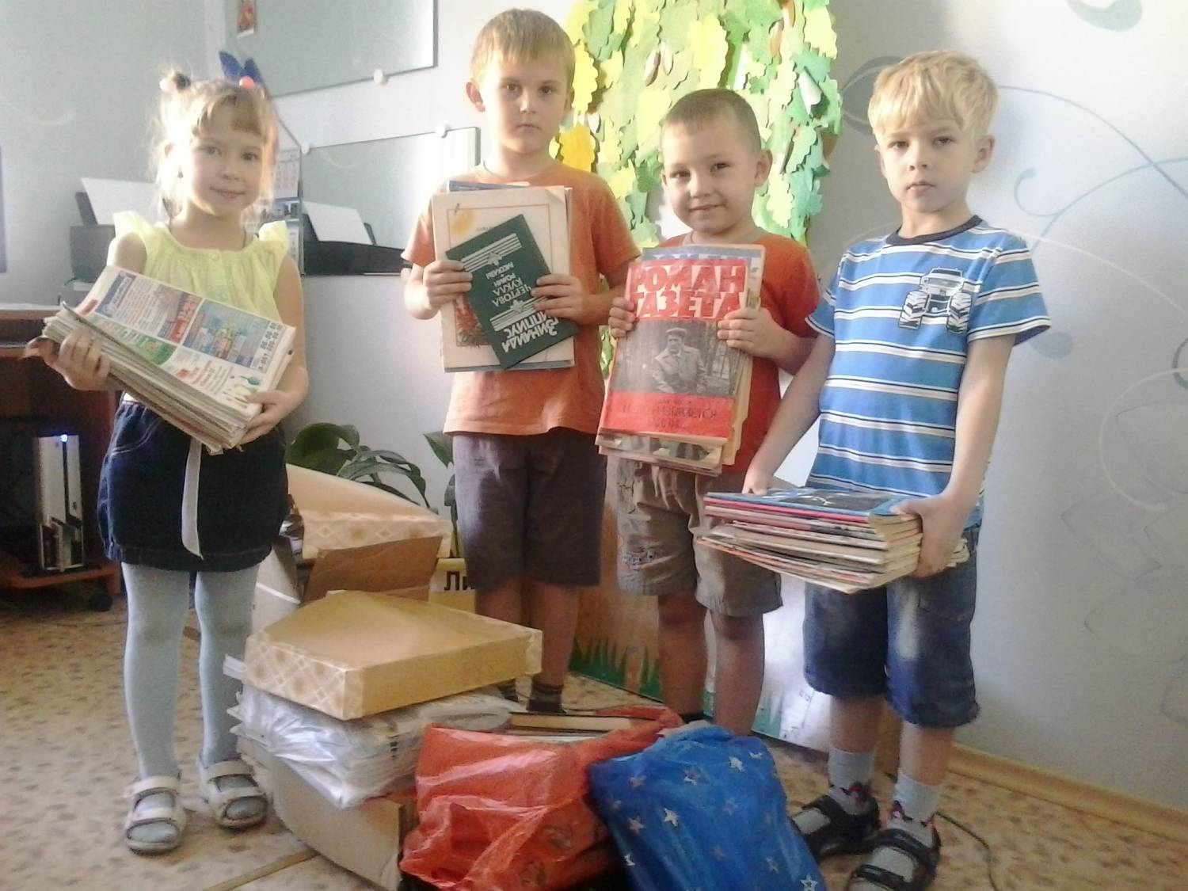
For the second team

Slide 22
Did you like this game?

